Slide 1
Welcome Principals, Directors and Enrollment Management Team Members

Slide 2
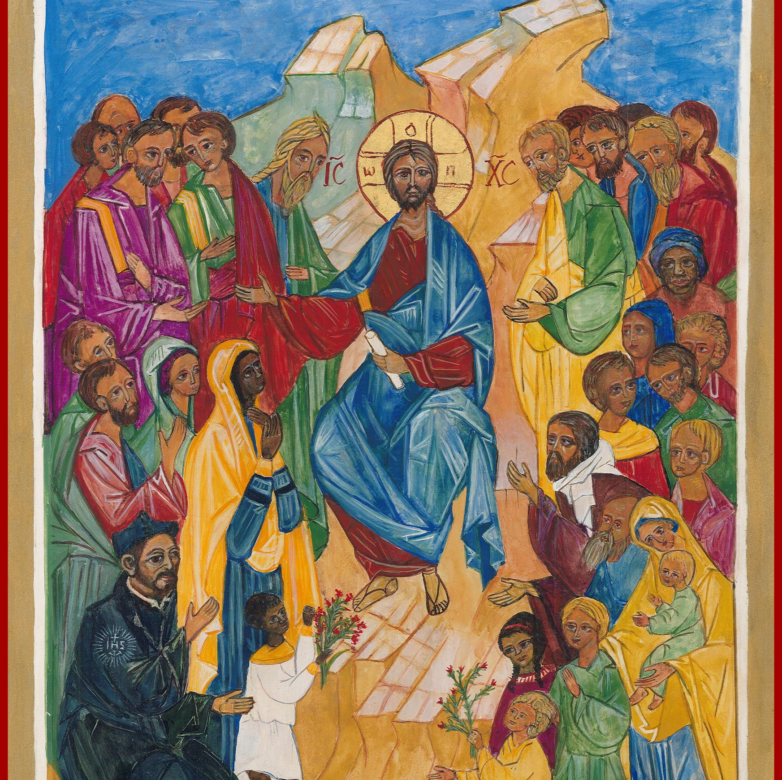
Prayer
Almighty God,
You sent forth your Son as a beacon of hope for all people.
As a Teacher, He has given us the prime example of the importance of education. As disciples, we look to him for inspiration and strength.
Thank you for the many people who have dedicated their lives in service to our Catholic Schools.
Thank you for the teachers and administrators who sustain our schools.
Thank you for the parents who have given support and witness to the importance of Catholic education.
Bless all our Catholic Schools and the many people who advance our mission.
May our schools be a home for those who seek to grow in openness, faith, love, intellect and commitment to justice.
In the name of the Father, and of the Son, and of the Holy Spirit, Amen.
Notes:
Prayer before Meetings
Heavenly Father, as we enter into this meeting, we bring your presence with us. We speak your peace, your grace, your mercy, and your perfect order. We acknowledge your power over all that will be spoken, thought, discussed, decided, and done during our meeting.
Lord, we thank you for the gifts you have given to us and we commit to using them responsibly in your honor. Give us a fresh supply of strength and compassion to do our job. Anoint our plans, ideas, and energies so that even our smallest accomplishment may bring you glory.
Lord, when we are confused, guide us, when we are anxious, comfort us, and when we are tired, infuse with the fire of the Holy Spirit.
May the work that we do and the way we do it bring faith, joy, and hope to all of those we serve today and every day.
We ask this through your son, Jesus Christ.
Amen.

Slide 3
Enrollment Management Team Training Session 2: Planning for Catholic Schools Week / Retaining Current Families 2024-25

Slide 4
Our Learning Goal… Enrollment Management Teams
Enrollment Management Team
Members will be able to…
Celebrate current strengths and powerful practices in enrollment
Identify opportunities for growth
Implement immediate steps to recruit and retain students and families

Slide 5
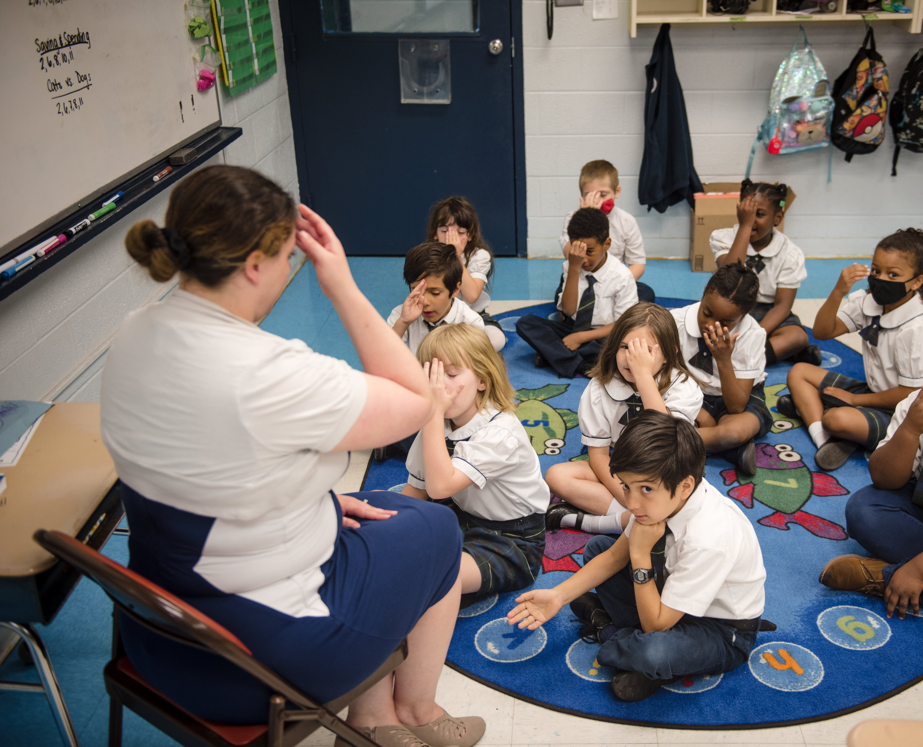
OPERATIONAL VITALITY Enrollment Management Teams
One day we will:
Be accessible to and inclusive of any student regardless of socio-economic status, race, cultural background, religious affiliation or learning exceptionality.
We will retain and attract students so that every seat in every classroom in every school will be filled.

Slide 6
OPERATIONAL VITALITY Enrollment Management Meetings and Topics
Wed. Nov. 6 10-11am Planning for Catholic Schools Week / Retaining Current Families
Wed. Jan. 15 10-11am Why Choose Catholic Schools? Hospitality and Welcoming
Wed. March 19 10-11am Why Choose Catholic Schools? Academic Excellence

Slide 7
OPERATIONAL VITALITY Enrollment Management Training - Questions
One day we will:
Be accessible to and inclusive of any student regardless of socio-economic status, race, cultural background, religious affiliation or learning exceptionality.
We will retain and attract students so that every seat in every classroom in every school will be filled.

Slide 8
Planning for Catholic Schools Week

Slide 9
Catholic Schools Week Overview
History and purpose
Key themes and messages

Slide 10
Planning Timeline
Key Dates and Milestones
Preparation Checklist

Slide 11
Event Ideas
Examples of successful events
Community involvement activities

Slide 12
Marketing and Promotion
Strategies for promoting events
Utilizing social media and local media

Slide 13
Engaging Students and Families
Activities to involve students
Family participation ideas

Slide 14
Collaborating with Parish and Community
Building partnerships
Involving parish leaders

Slide 15
Showcasing School Achievements
Highlighting academic and extracurricular successes
Testimonials from students and parents

Slide 16
Open House Events
Planning and executing open houses
Tips for making a great impression

Slide 17
Sustaining Success: Strategies for Retaining Families in Catholic Schools

Slide 18
Poll: When does your application period open?

Slide 19
Retention Strategies
Importance of retaining current families
Key retention strategies

Slide 20
Communication with Families
Effective communication methods
Regular updates and newsletters

Slide 21
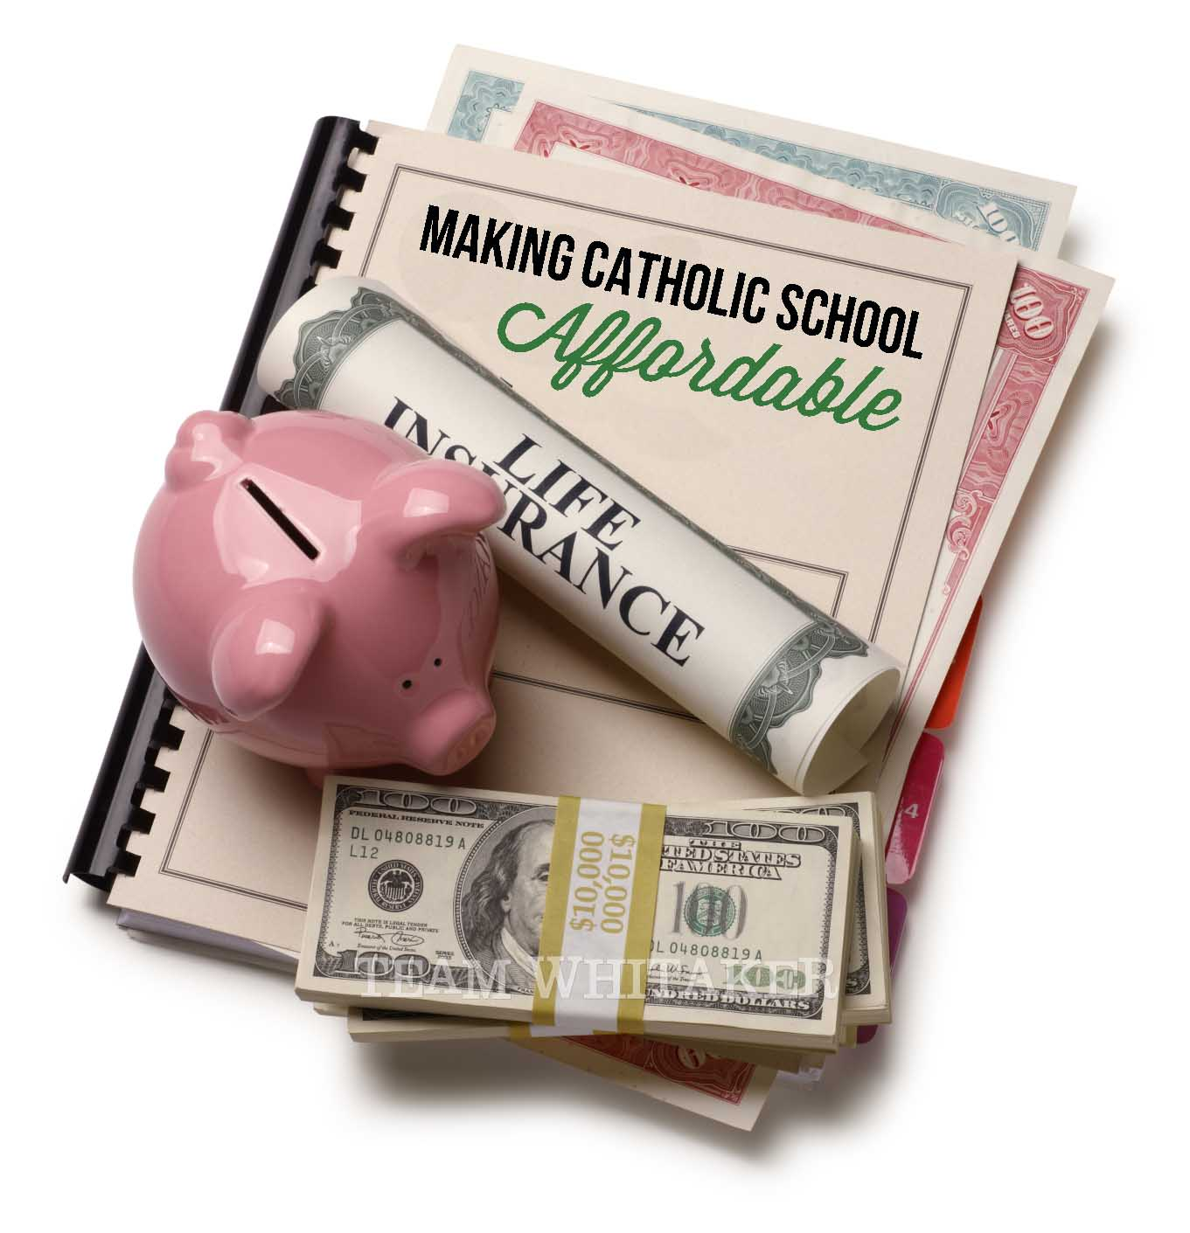
Feedback and Surveys
Gathering feedback from families
Using surveys to improve

Slide 22
Support Services
Providing support for families
Resources available

Slide 23
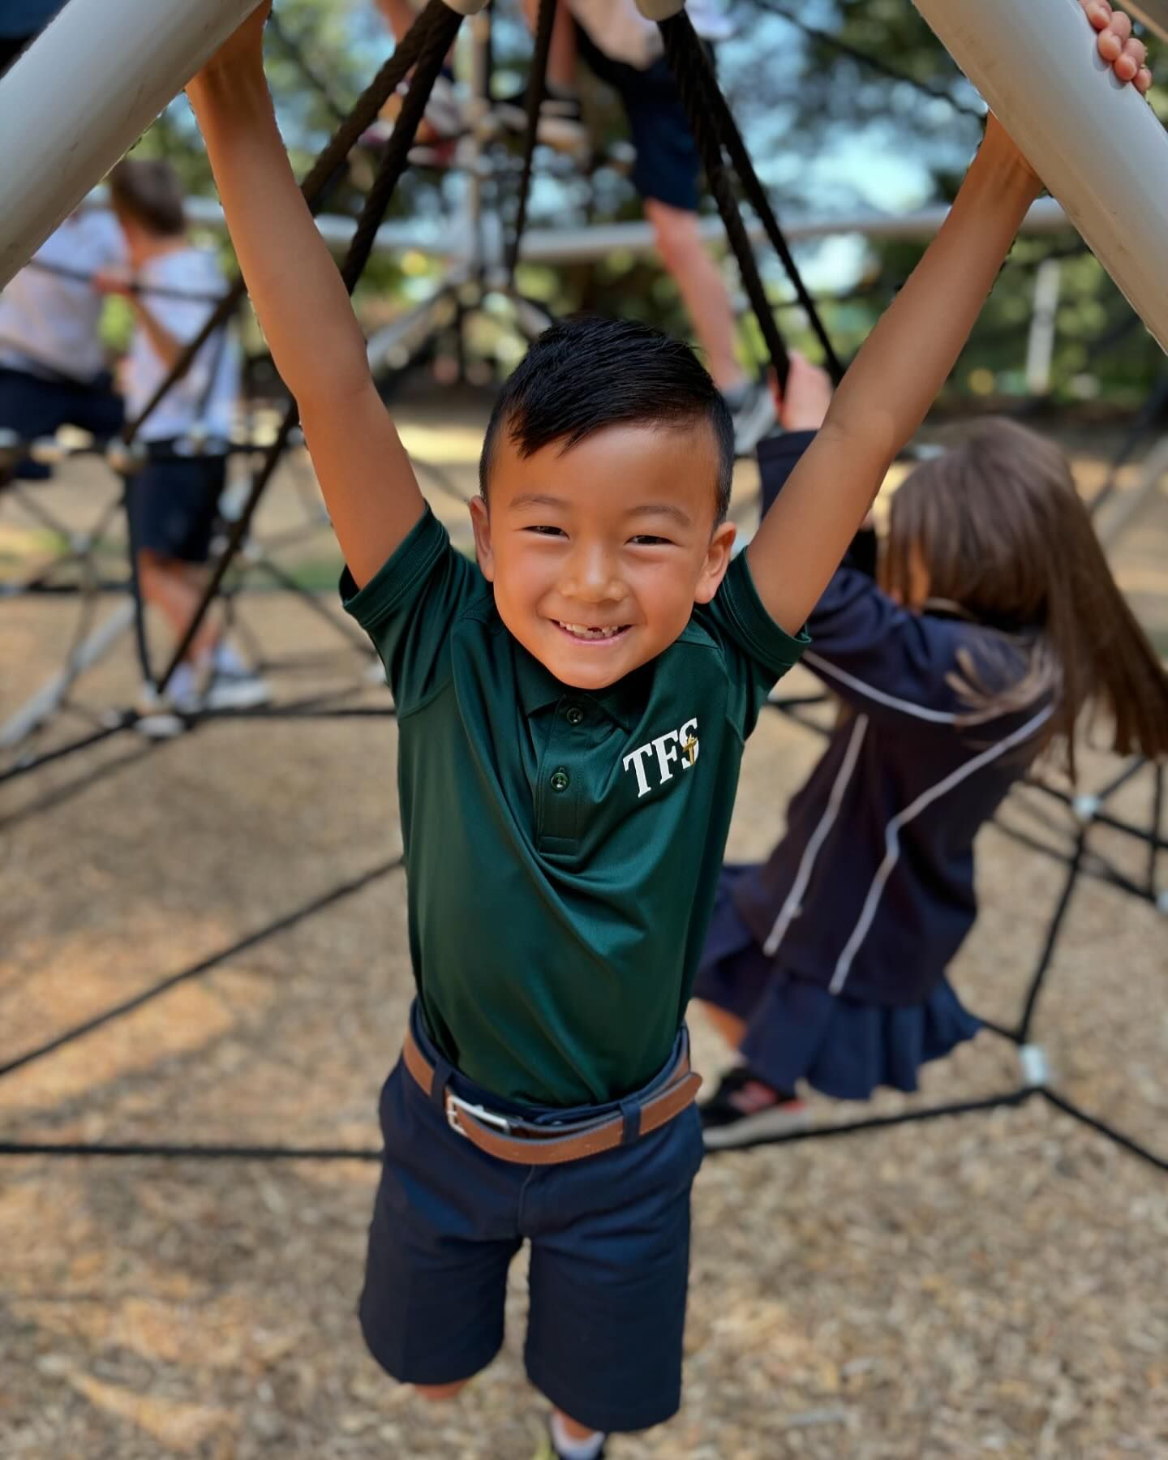
Financial Incentives
Scholarships and financial aid
Incentives for returning families

Slide 24
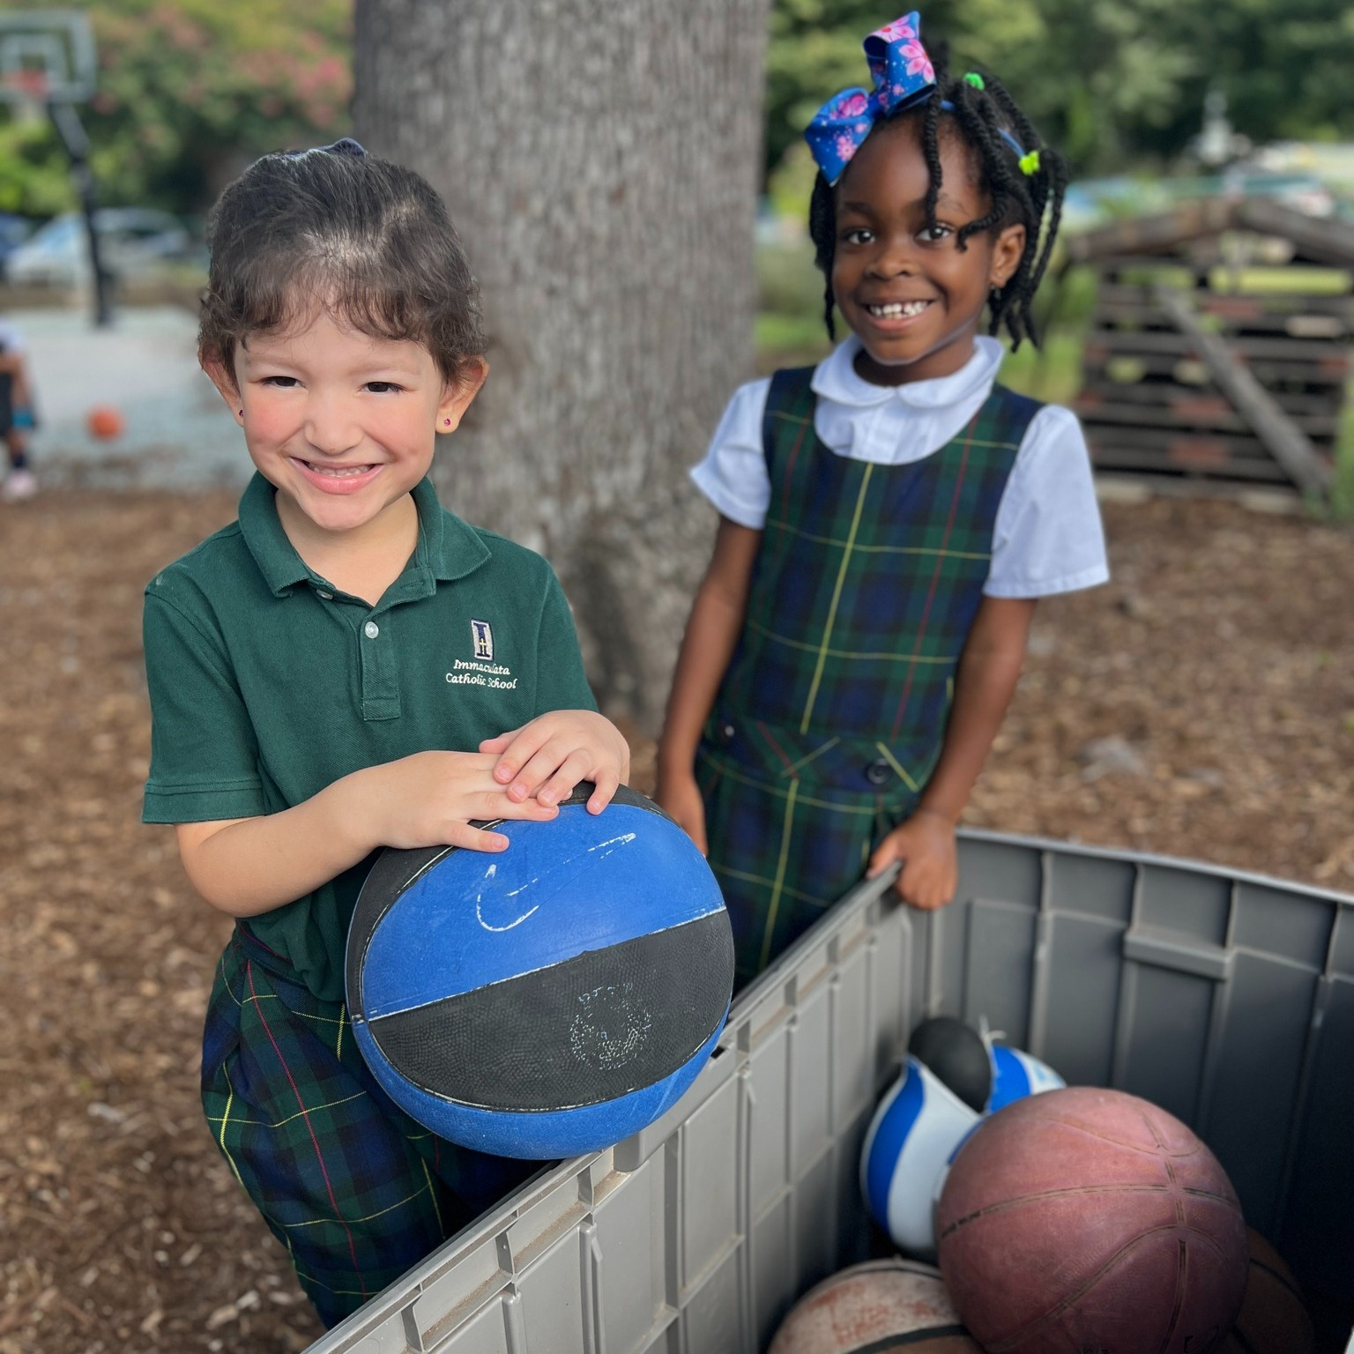
Alumni Involvement
Engaging alumni in school activities
Alumni success stories

Slide 25
Prayer
Loving God,
You are present to us whenever we gather as a faith community.
We pray that our schools will be places where everyone feels accepted, safe, and beloved.
Help our schools and our local communities be places of faith so that we can help others believe in You.
Fill us with Your Spirit so that we may reflect Your light and love to each other and the whole world as one Body of Christ.
Amen.
Notes:
Prayer before Meetings
Heavenly Father, as we enter into this meeting, we bring your presence with us. We speak your peace, your grace, your mercy, and your perfect order. We acknowledge your power over all that will be spoken, thought, discussed, decided, and done during our meeting.
Lord, we thank you for the gifts you have given to us and we commit to using them responsibly in your honor. Give us a fresh supply of strength and compassion to do our job. Anoint our plans, ideas, and energies so that even our smallest accomplishment may bring you glory.
Lord, when we are confused, guide us, when we are anxious, comfort us, and when we are tired, infuse with the fire of the Holy Spirit.
May the work that we do and the way we do it bring faith, joy, and hope to all of those we serve today and every day.
We ask this through your son, Jesus Christ.
Amen.

